Slide 1

Soccer Match Prediction
Christopher Semaan &
Bardia Parmoun

Slide 2


Introduction

Slide 3
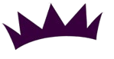
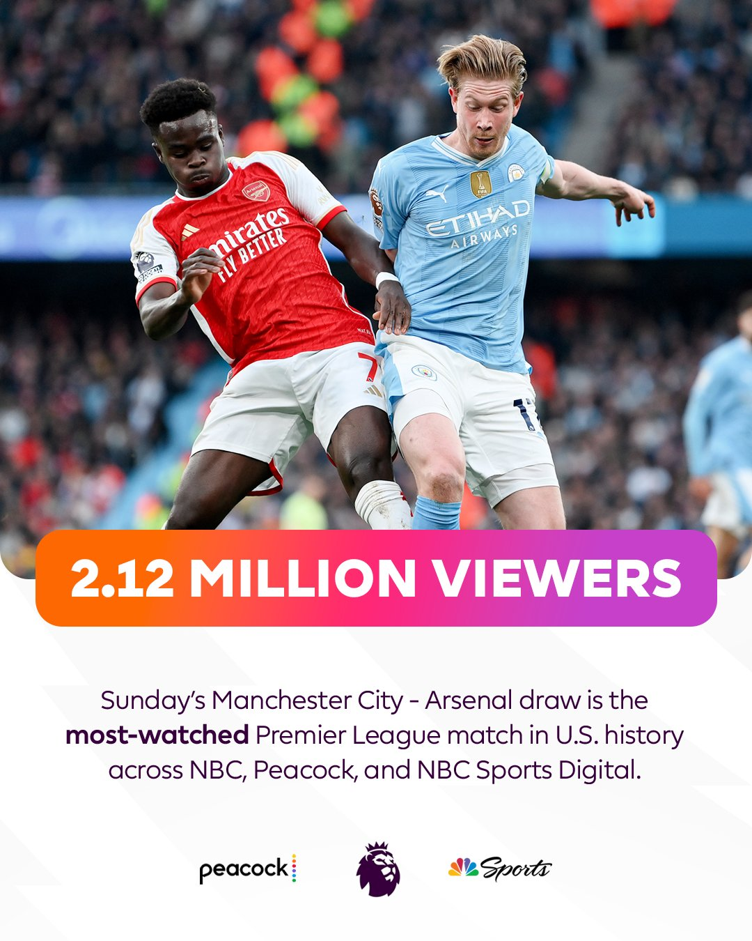
Motivation
Premier League: 900 million homes worldwide [1]
4% YOY growth in new markets [1]
Record breaking viewership in 2024 [1]

Slide 4
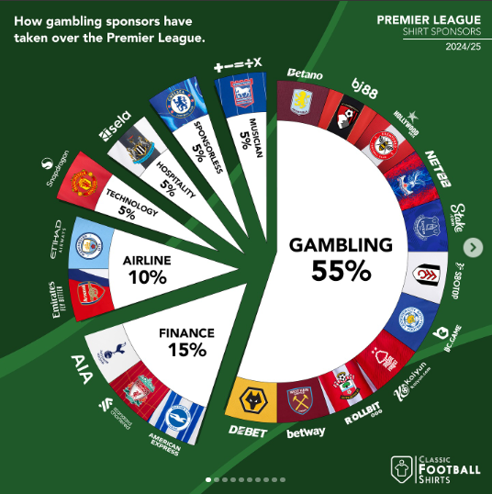
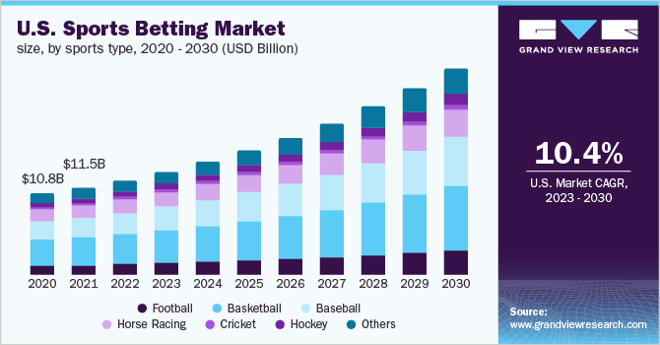
Growth of Sports Gambling
11 Clubs sponsored by gambling [2]
10.4% Annual Growth Rate
83.65 billion USD worldwide [3]

Slide 5

Objective
Predict Match Results (Home Win, Draw, Away Win)
Maximize profit based on each match’s given odds

Slide 6
Dataset Search Requirements
Real match results
Pre-match data: e.g number of shots on target
Predictive match metrics: e.g expected goals
Existing Odds for the outcome → to evaluate the model

Slide 7
Background

Slide 8
What are odds?
A payout ratio [4] -> i.e 5:1 means earn 5 times the bet amount
Often made by professional odds makers
Inversely correlated with likelihoods
Lowest odd -> most likely outcome
Profit calculation using odds:

Slide 9
Possible approaches
Traditional odds making
Using insider information
Historical analysis
Machine Learning
Simple models: Support Vector Machines, random forest
Deep learning: FNN, RNN, LSTM

Slide 10
Survey of existing solutions
Odds makers: traditional odds makers (i.e Bet365) [5]
Performance: usually has an accuracy of ~55% on average
Voting model: FNN and Random Forest [6]
Features: goals, fouls, cards, penalty kicks, own goals, free kicks, own goals …
Performance: only achieved an accuracy of 46.6%
Sequential model: RNN and LSTM [7]
Features: win/loss streaks (3 and 5 matches), past 4 results, goals scored, …
Performance: the model achieved an accuracy of 81.75%
Does not predict draws and outperforms other models by ~20% -> maybe not reliable

Slide 11
Survey of existing solutions
Decision Trees: Random Forest and Gradient Boosting [8]
Features: rank difference, goal difference, goal per rank differences, …
Performance: achieved an accuracy of 71.72%
Deep Multi-layer Learning: 5 layer FNN [9]
Features: shots, shots on target, corners, fouls, first-half and total goals, …
Performance: only achieved an accuracy of 61.14%
Stacking Model: CNN, SVM, Logistic Regression, and Random Forest [10]
Features: total time, cards, fouls, corners, shots on target, humidity, temperature, wind speed, weather conditions, …
Performance: the model achieved an accuracy of 62.6% and a F1 score of 59.2

Slide 12
Selected Approach
Multi-layer Feedforward Neural Network (FNN) - 5 layers
FNN was used in the majority of the existing approaches
Deep learning is preferred due to complexity -> no random forest
Historical data is already aggregated -> RNN and LSTM not needed
All the fields are simple numerical values -> CNN not needed
Lots of features -> need to optimize training time so no transformers
Expectations:
Accuracy ranges between low 40-60% -> we aim to get ~50%

Slide 13
System
Description

Slide 14
Dataset Detailed
Columns | Type
team_a_shots_average team_a_shots_overall_TSR team_a_ratio_shotsOnTarget_overall team_a_ppg_dif_l6 position_a_prematch … | Prematch (Historical)
predict_xg_overall_team_a predict_xg_home_team_a … | Predictions
odds_ft_1 profit_1 … | Betting information
45 Columns
57819 Matches

Slide 15
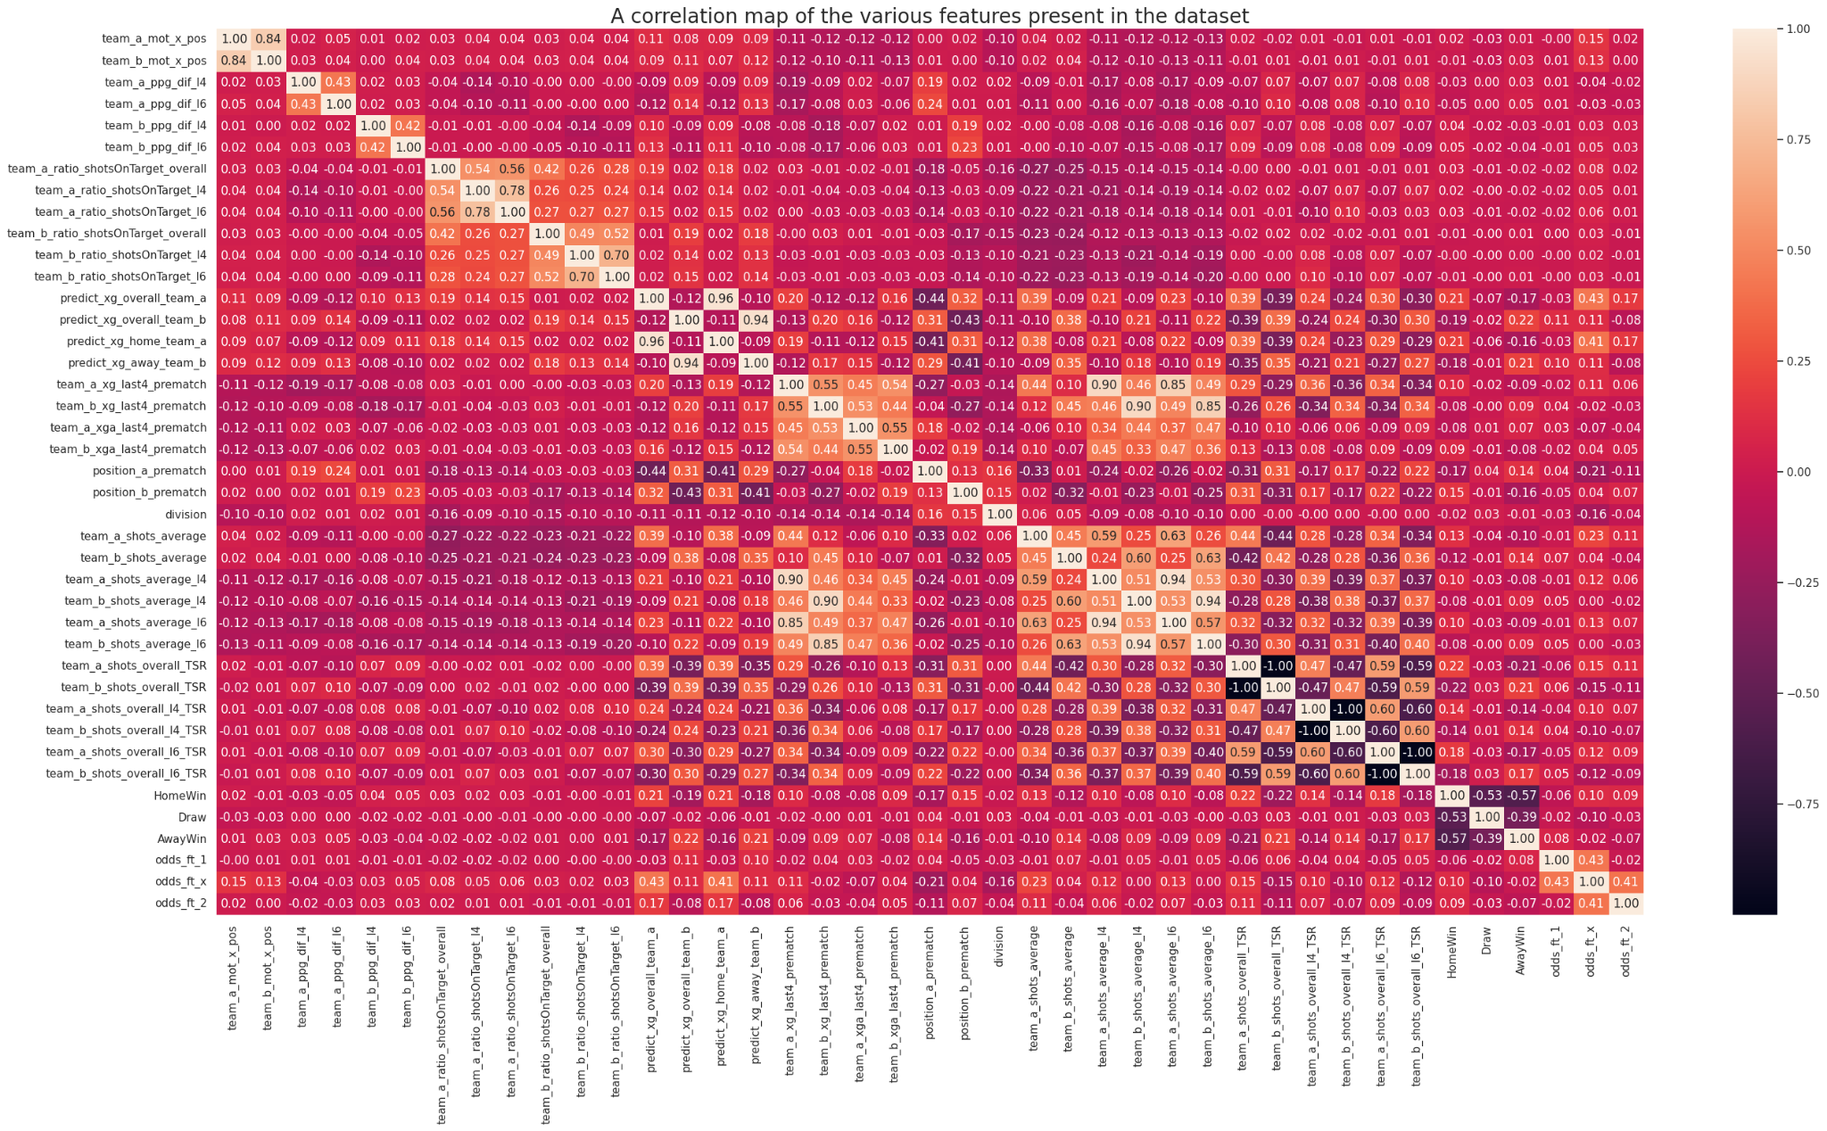
Analyzing the columns
Important columns:
xG vs Results
Total Shot Ratio vs Results
Ignored Columns:
Betting Information:
'profit_1', 'profit_X', 'profit_2'
Profit metric was used instead
'odds_ft_1', 'odds_ft_X','odds_ft_2'
Redundant Features:
'team_a_ratio_shotsOnTarget_l6'
'team_a_ratio_shotsOnTarget_l4'
'team_b_ratio_shotsOnTarget_l6'
'team_b_ratio_shotsOnTarget_l4'
Already correlated with TSR!

Slide 16
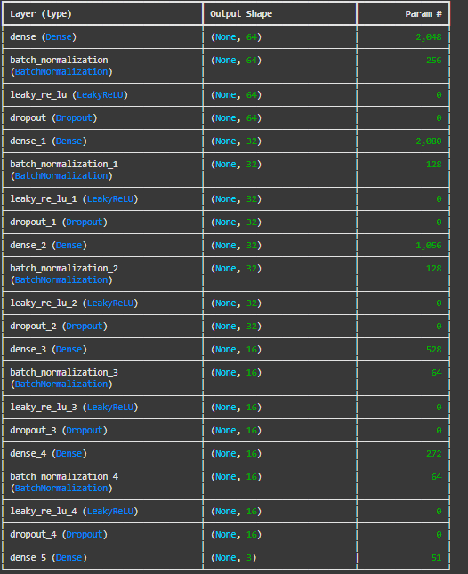
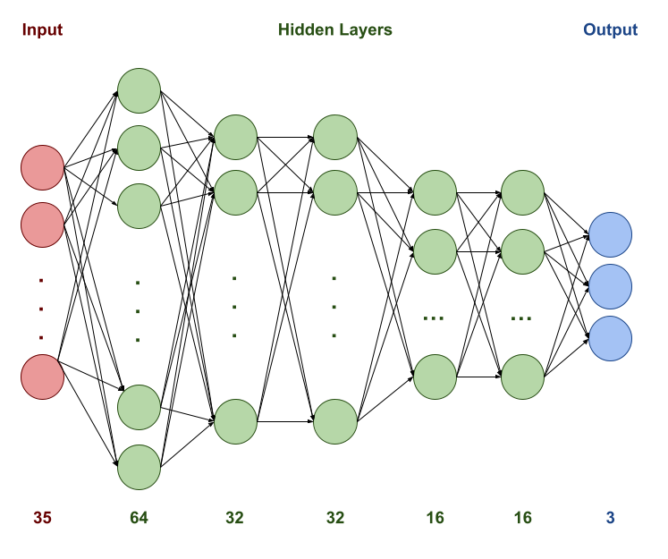
Model Description

Slide 17
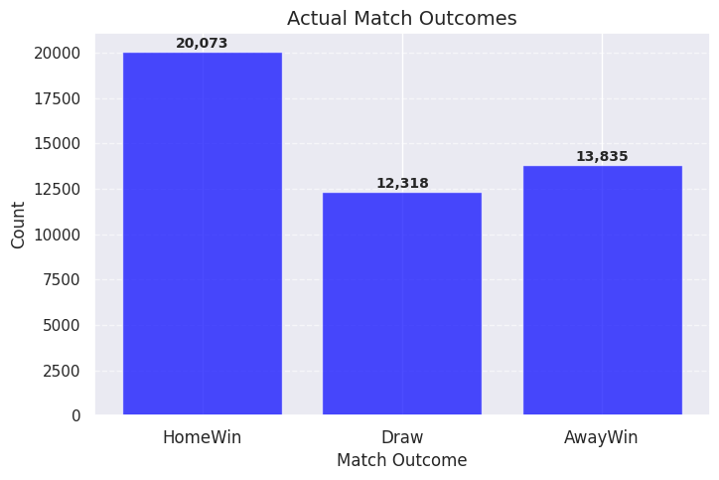
Our Algorithm
Feedforward Network
Input: 35 features
Layer 1: 64 Neurons
Layer 2, 3: 32 Neurons
Layer 4, 5: 16 Neurons
Output layer: 3 Neurons
All layers
L2 Regularization: 0.2 Factor
Batch Normalization
Leaky ReLU: -0.01 slope
Dropout: 0.2 rate
Balanced class weights for Draw & AwayWin
Adam Optimizer
Adaptive learning rate
0.1 reduction factor
3 epoch patience factor
Notes:
Funnel layer sizes to funnels down features
Having two layers with the same size (like 32 → 32) is common and can help learn richer representations.
L2 Regularization: Helps prevent overfitting by penalizing large weights.
Batch Normalization: Stabilizes and speeds up training.
Leaky ReLU: Avoids the “dying ReLU” problem.
Dropout: Further reduces overfitting by randomly deactivating neurons during training.
This helps prevent overshooting and can lead to better convergence over time, especially with a high initial learning rate like 0.1.

Slide 18

Testing and Training
Blind test split: 20% reserved for blind test
The training data is further split:
5-Fold Cross Validation
70% Training on Cross Validation
10% Validation
20% Testing
Final Validation
90% Training
10% Validation
Training Parameters
50 Epochs
32 Batch Size

Slide 19
Numerical
Results

Slide 20
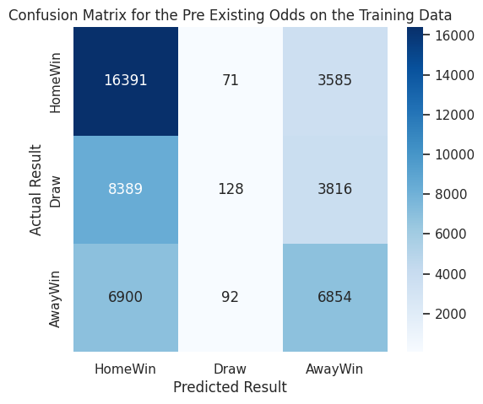
Existing Odds on the Training Data
The existing odds have an accuracy of 50.56% on all the training data
Profit Metric: The odds results in a net profit of $-2401.60
Heavily biased against draws!

Slide 21
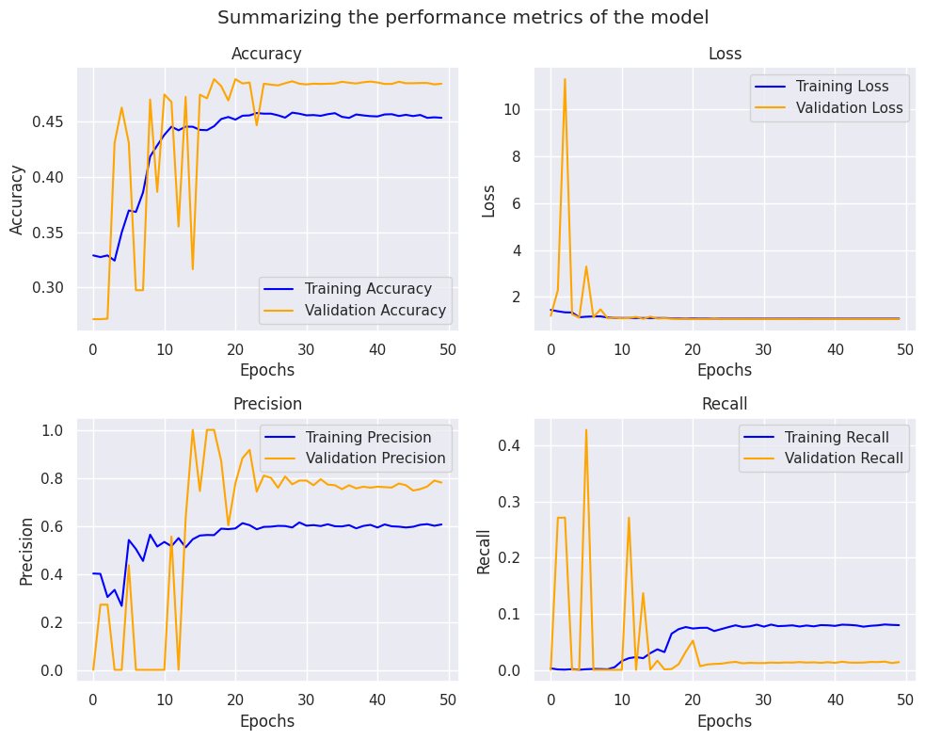
Model Performance during Cross Validation
F1 score: 46.28 ± 1.58
Model’s net profit: $-441.47 ± $122.94
Odd’s net profit: $-505.19 ± $40.79
Maximum accuracy: 48.43%

Slide 22
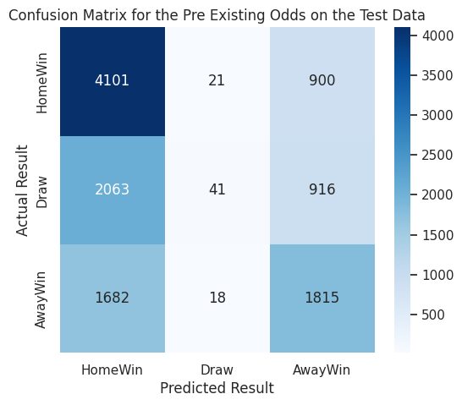
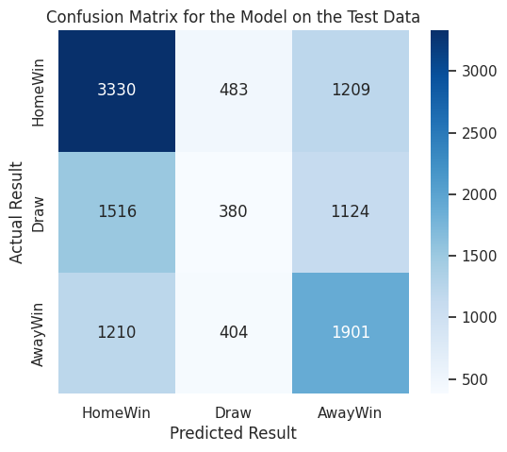
Performance on the Blind Test Data
Existing Odds
The Model
Accuracy: 51.54% Net Profit: $-330.72
Accuracy: 48.55% Net Profit: $-372.68

Slide 23
Findings
Performance:
Performs closely to existing odds!
Outperforms random (33%) by 15%!
Better than some of the existing models!
less bias towards draws -> compared to the odds
Recall is not good -> the model is too strict!
Accuracy does not cross 50% -> need more features

Slide 24
Conclusion

Slide 25
Conclusions
Summary:
Our best statistical run reached 48.43% accuracy
Our results were more balanced towards Draws and Away Wins than the odds makers
Suggestions:
More samples would make the model more consistent and accurate
Include player specific features or more diverse team factors

Slide 26

Final Thoughts
Soccer is NOT science!
Lots of hidden factors!
Example: Manchester City vs Cardiff City [5]
Bet365 odds for Cardiff win were 9:1
Manchester City had 74% possession
Manchester City had 10 shots on target as opposed to Cardiff’s 4
Yet, Cardiff won 2-0!

Slide 27
References
[1] The numbers that show this has been a season like no other. Available:
https://www.premierleague.com/news/4027356. Accessed: 2025-03-26.
[2] @classicfootballshirts. Gambling sponsors in the premier league 2024/25. Available:
https://www.instagram.com/classicfootballshirts/p/C-slVewK-_a/?img_index=7. Accessed:
2025-03-26.
[3] Grandview Research. Sports betting market size, share & trends analysis report by
platform, by betting type (fixed odds wagering, exchange betting, live/in-play
betting, esports betting), by sports type, by region, and segment forecasts, 2023 - 2030. Available: https://www.grandviewresearch.com/industry-analysis/sports-betting-market-report. Accessed: 2025-03-26.
[4] Shehryar Sohail. Sports betting odds: How they work and how to read them. Available:
https://www.investopedia.com/articles/investing/042115/betting-basics-fractional-decimal-american-moneyline-odds.asp. Accessed: 2025-03-28.
[5] socceranalytics. Predictions in soccer: Getting things right more often than wrong. Available:
https://socceranalytics.org.uk/predictions-in-soccer/. Accessed: 2025-03-28.

Slide 28
References
[6] Sherif Saad Haytham Elmiligi. Predicting the outcome of soccer matches using machine learning
and statistical analysis. Available: https://ieeexplore.ieee.org/document/9720896. Accessed:
2025-03-27.
[7] Sarika Jain. Soccer result prediction using deep learning and neural networks.
Available:https://www.researchgate.net/publication/349272309_Soccer_Result_Prediction_Using_Deep_Learning_and_Neural_Networks. Accessed: 2025-03-28.
[8] Xiangkun Meng. Soccer match outcome prediction with random forest and gradient boosting
models. Available: https://www.researchgate.net/publication/378355415_Soccer_match_outcome_prediction_with_random_forest_and_gradient_boosting_models. Accessed: 2025-03-27.
[9] Sergei Bezobrazov Sergei Anfilets. Deep multilayer neural network for predicting the winner of
football matches. Available: https://www.researchgate.net/publication/342416626_DEEP_MULTILAYER_NEURAL_NETWORK_FOR_PREDICTING_THE_WINNER_OF_FOOTBALL_MATCHES. Accessed: 2025-03-28.
[10] Eugene Li Albert Wong. A predictive analytics framework for forecasting soccer match outcomes
using machine learning models. Available:
https://www.sciencedirect.com/science/article/pii/S2772662224001413. Accessed: 2025-03-28.

Slide 29
Thank you!

